Slide 1
INFO-H420
Management of Data Science and Business Workflows
Part II Fairness
Dimitris SACHARIDIS
2023-2024

Slide 2
How do people feel about interacting with AI systems?
There was survey conducted by PegaSystem among 5000 consumers regarding their interaction with AI Systems.
34% say they interact with AI systems
Some said that machines are not trustworthy
only 9% very comfortable interacting with AI
Some said that machines can be biased
53% say it’s possible for systems to show bias in their decisions
Some said that machines cannot be moral
56% don’t believe it is possible to develop systems that behaves morally

Slide 3
Responsible Data Science
Responsible data science is the practice of using data and data-driven techniques in a way that is ethical, transparent, and respectful of the rights and interests of individuals and society
Key concepts:
Data privacy and security, to protect sensitive data of individuals
Transparency about data sources, methods, and limitations
Exhibit desirable ethical principles
Put human in control, allow them to understand and control
ChatGPT, December 2022

Slide 4
Responsible AI/ML/Data Science
Algorithmic Decisions (e.g., from ML/AI models) are ubiquitous, permeate many aspects of society
more and more questions of responsible use arise Fairness Accountability Transparency Ethics
dedicated conferences
ACM Conference on Fairness, Accountability, and Transparency (FAccT)
AAAI/ACM Conference on Artificial Intelligence, Ethics, and Society (AIES)
topics appear in almost all CS venues
courses: in Berkeley, Cornell, Princeton
EU high-level expert group on AI: Ethics Guidelines for Trustworthy AI
EU upcoming regulation: AI Act

Slide 5
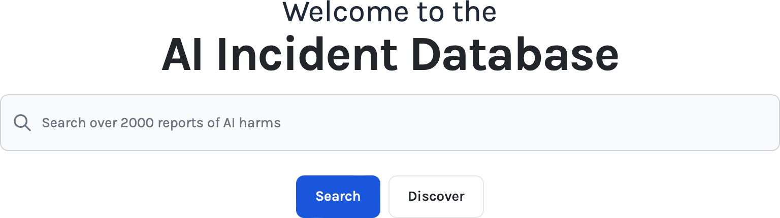
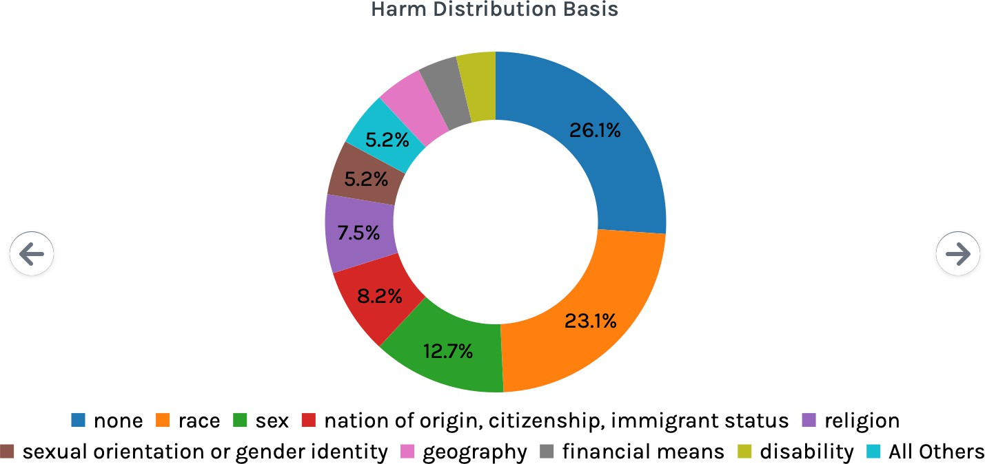
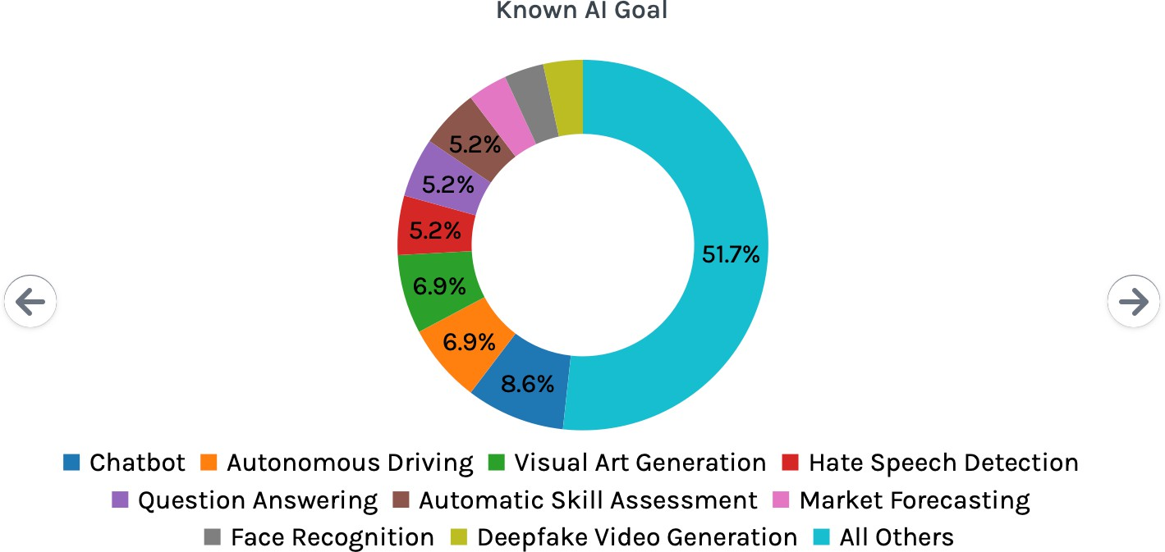
Irresponsible AI
https://incidentdatabase.ai
5

Slide 6
Ethical Principles
Ethical principle | Number of documents | Included codes
Transparency | 73/84 | Transparency, explainability, explicability, understandability, interpretability, communication, disclosure, showing
Justice & fairness | 68/84 | Justice, fairness, consistency, inclusion, equality, equity, (non-)bias, (non-)discrimination, diversity, plurality, accessibility, reversibility, remedy, redress, challenge, access and distribution
Non-maleficence | 60/84 | Non-maleficence, security, safety, harm, protection, precaution, prevention, integrity (bodily or mental), non-subversion
Responsibility | 60/84 | Responsibility, accountability, liability, acting with integrity
Privacy | 47/84 | Privacy, personal or private information
Beneficence | 41/84 | Benefits, beneficence, well-being, peace, social good, common good
Freedom & autonomy | 34/84 | Freedom, autonomy, consent, choice, self-determination, liberty, empowerment
Trust | 28/84 | Trust
Sustainability | 14/84 | Sustainability, environment (nature), energy, resources (energy)
Dignity | 13/84 | Dignity
Solidarity | 6/84 | Solidarity, social security, cohesion
review of 84 AI ethics guidelines
trust is the “end goal”
[2019 Nature Machine Intelligence A. Jobin et al.] Artificial Intelligence: the global landscape of ethics guidelines

Slide 7
Fairness
7

Slide 8

Bias in Data-Driven Decisions
A risk assessment software was developed by Northpointe called that estimates the likelihood of a criminal to reoffend
based on a detailed question-based profiling of the people
It is used by judges in the US to guide their decisions
about sentences, bail amounts
ProPublica, a news organization, analyzed the predictions of COMPAS
looked at more that 10,000 offenders
compared the predictions of COMPAS
with what actually happened (did they reoffend?)
https://incidentdatabase.ai/cite/40/

Slide 9
Bias in Data-Driven Decisions
results of the study:
correctly predicts reoffending for black and white at the same rate
same recall (true positive rate, sensitivity)
but mistakes paint a different picture:
blacks are almost twice as likely as whites to be labeled a higher risk
but not actually reoffend
more false positives for blacks
black are much less likely than whites to be labeled lower risk, but actually reoffend
less false negatives for blacks
i.e it was observed that system was having discrimination against blacks

Slide 10
Algorithmic Decisions
What are the issues here?
fairness – is the system actually fair to racial groups?
transparency – we don’t know what the algorithm does
accountability – who is to hold responsible?

Slide 11
What is Fairness?
Dictionary: “the state of being free from bias or injustice”
Political Science: “distributive justice discusses fair allocation of resources among diverse members of a community”
“A Theory of Justice” by J. Rawls (American philosopher)
“justice as fairness”; “social cooperation should be fair to all citizens regarded as free and as equals”
but what is a fair allocation?
equality of outcome: each person get the same amount
equality of opportunity: equal grounds for competing for resources
social welfare: what benefits the society the most

Slide 12
What is Fairness?
Legal Systems: “fairness as non-discrimination”
disparate treatment: intentional discrimination on protected groups (defined on race, color, sex, etc.); not “color-blind”
e.g., only African American applicants are required to take a pre-employment assessment test
disparate impact: a procedure that has disproportionate impact on protected groups
e.g., all applicants are tested but only African Americans are eliminated based on the results of the assessment.
affirmative action: promote non-discrimination and support historically disadvantaged groups; quota systems
e.g., to address gender imbalance in STEM
To promote female, in school more females are accepted than male

Slide 13
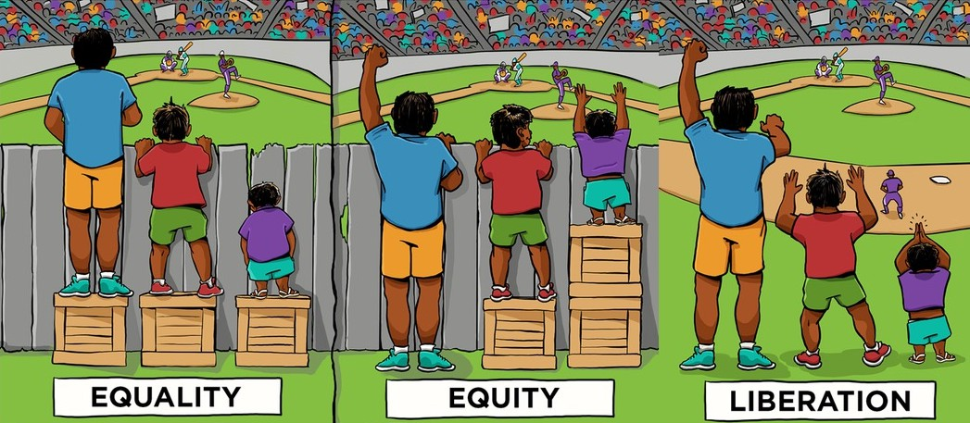
Algorithmic Fairness
Data-Driven Systems often make decisions on behalf of humans
high-stake decisions: likelihood to reoffend; grant a loan application
innocuous decisions: which article to read; what to buy in a store
or not so innocuous? fake news, filter bubbles
Algorithmic Fairness: machine made decisions should not discriminate against individuals

Slide 14
Group vs Individual Fairness
Group Fairness
a specific protected group defined by a sensitive attribute (e.g., race, gender) should be treated/impacted similarly to the other (non-protected) groups
typically two groups protected (disadvantaged) and non- protected (advantaged)
Individual Fairness
a specific individual should be treated/impacted similarly to a similar other individual
If I got some opportunity, another person of same gender should also get that opportunity
That is what is meant by saying similar

Slide 15
Classification based on Tasks
Task
Data
Outcome
Fairness depends on the type of task and its outcomes
Classification
Ranking
Recommendation

Slide 16
Fairness in Classification

Slide 17
Classification
assume binary classification (positive or negative classes)
e.g., accept a loan
assume group fairness: protected vs. non-protected group
assume that some score predicts the likelihood of being in the positive class
e.g., a credit score
a score threshold determines the classification outcome
e.g., scores above threshold mean positive
negative
positive
score
worse
threshold
better

Slide 18
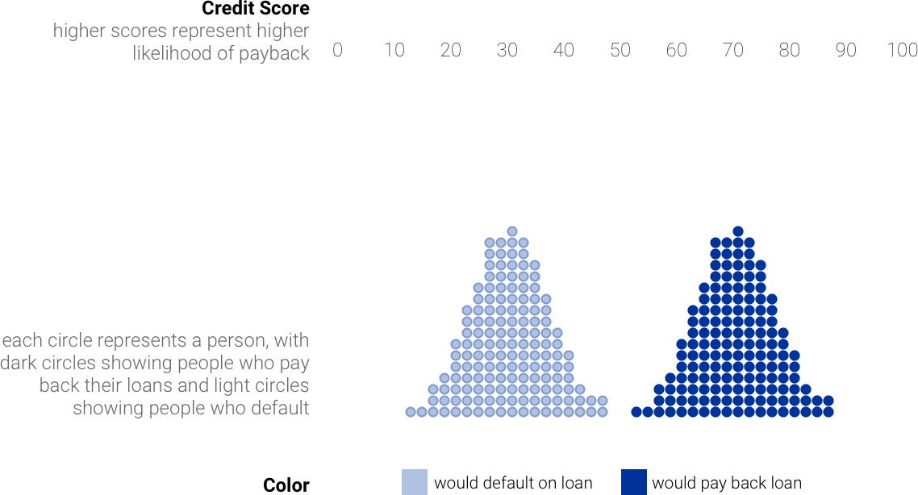
How should we set the threshold?
http://research.google.com/bigpicture/attacking-discrimination-in-ml/

Slide 19
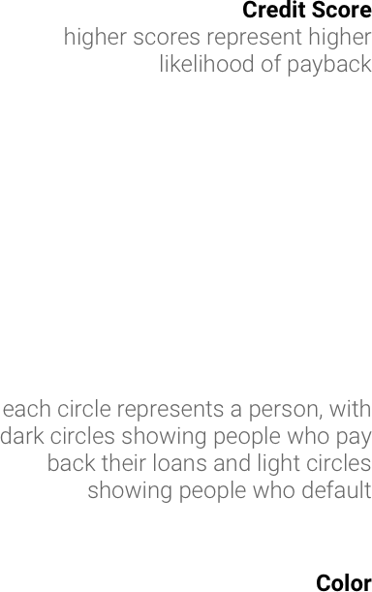
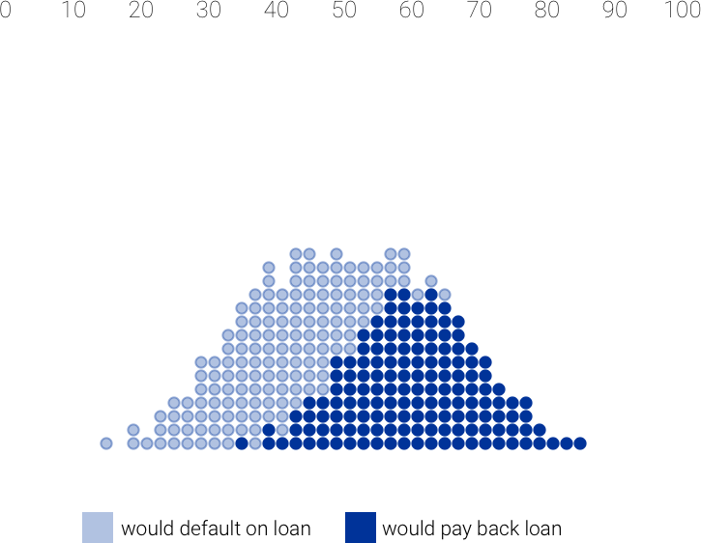
How about now?

Slide 20
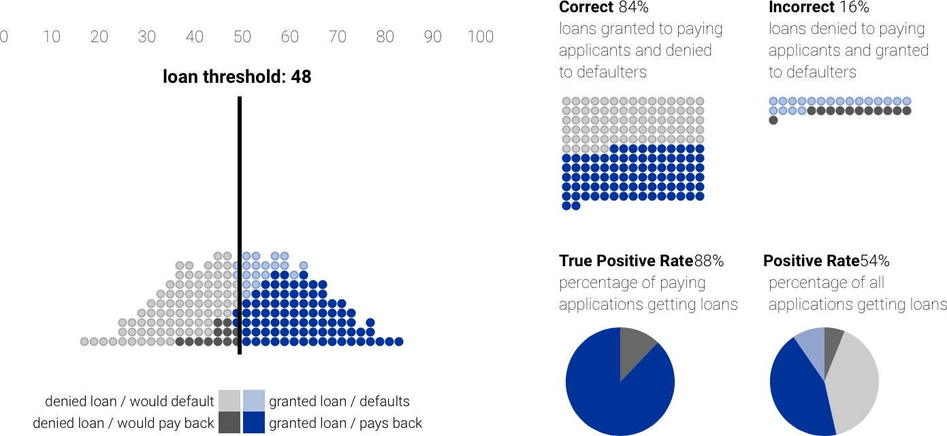
How should we set the threshold?
accuracy
recall
true negative (TN)
false positive (FP)
false negative (FN)
true positive (TP)

Slide 21
A true positive is an outcome where the model correctly predicts the positive class. Similarly, a true negative is an outcome where the model correctly predicts the negative class. A false positive is an outcome where the model incorrectly predicts the positive class.

Slide 22
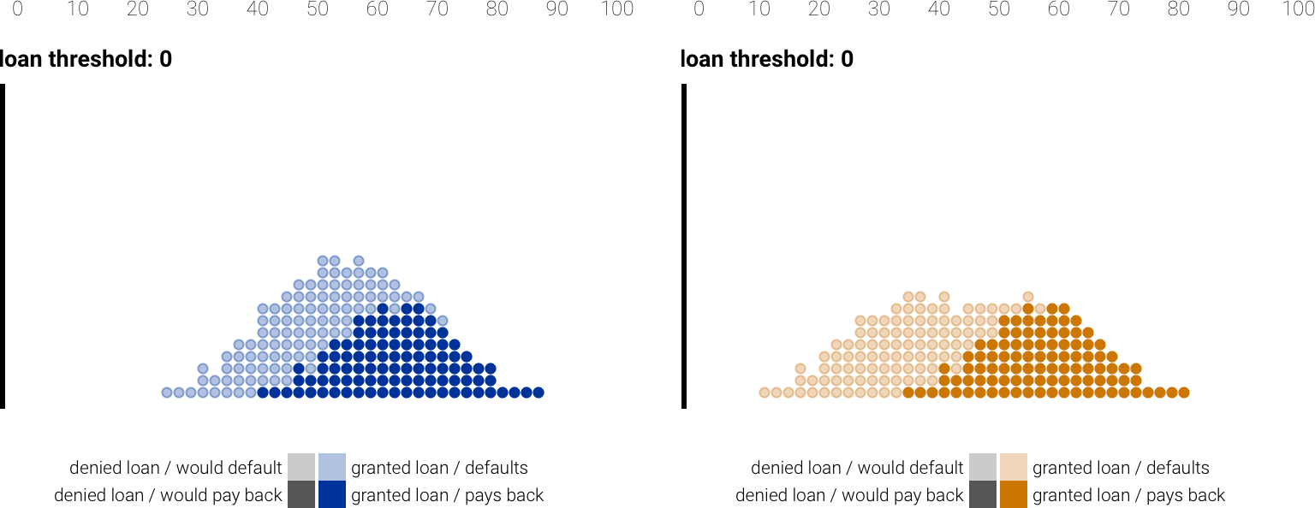
Two groups: Blue and Orange
How should we set the thresholds for the two groups?

Slide 23
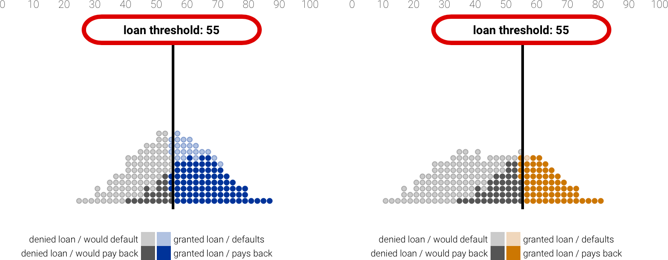
Equal Treatment (Color-Blindness)
We don’t look at color, set the same threshold.
23

Slide 24
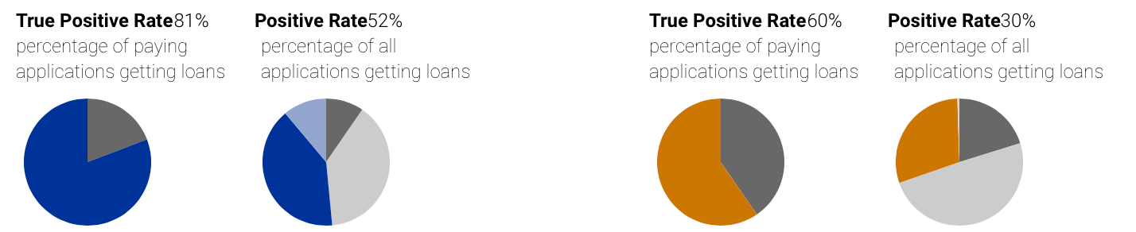
Equal Treatment (Color-Blindness)
We don’t look at color, set the same threshold.
23

Slide 25
Equal Treatment (Color-Blindness)
We don’t look at color, set the same threshold.
But what about impact? Which group is more likely to get a loan?
23

Slide 26
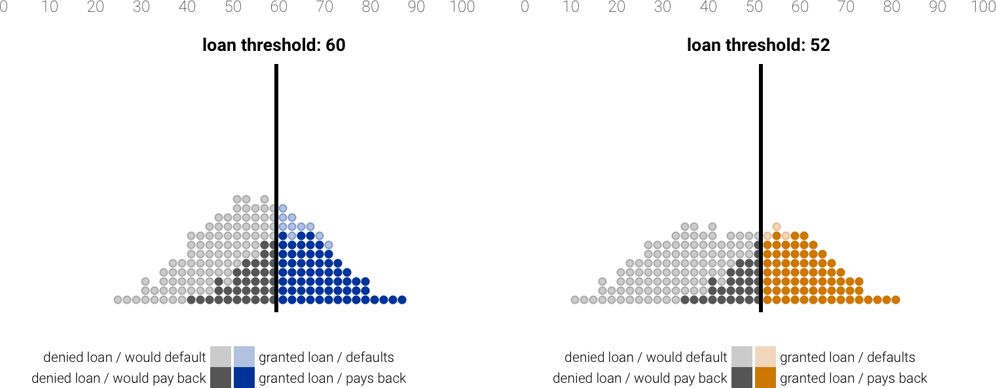
Group (Demographic/Statistical) Parity
Set different thresholds so that groups have equal chance of getting a loan (equal impact)

Slide 27
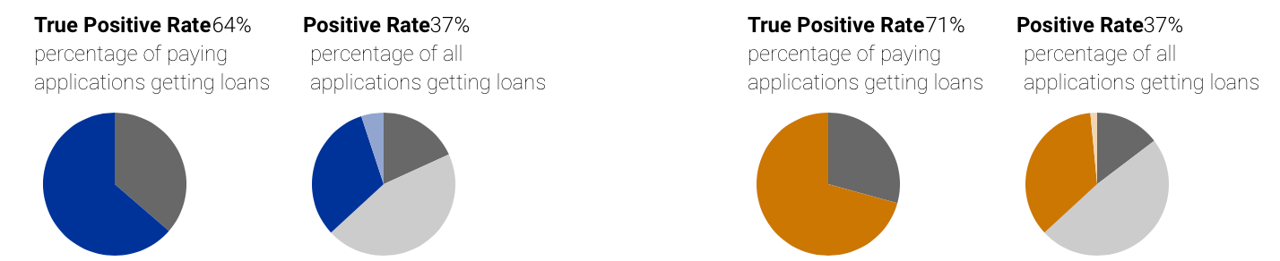
Group (Demographic/Statistical) Parity
Set different thresholds so that groups have equal chance of getting a loan (equal impact)
When we have two groups and we have set same threshold for them, the probability that both group will get loan might be different. In that case we might need to set different threshold for different groups.

Slide 28
Group (Demographic/Statistical) Parity
Set different thresholds so that groups have equal chance of getting a loan (equal impact)
But look at those who would pay back the loan; are they impacted the same?

Slide 29

Equal Opportunity
Aim to be fair for those that would pay back the loan
If we are good then we have equal opportunity to get the loan no matter what is your color

Slide 30
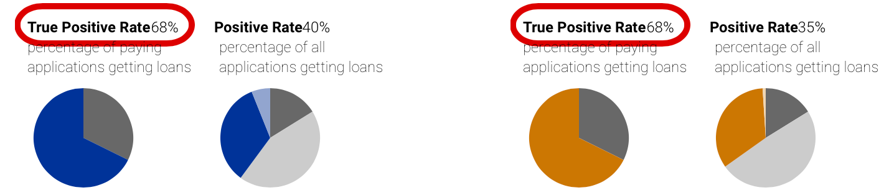
Equal Opportunity
Aim to be fair for those that would pay back the loan

Slide 31
Fairness Notions
equal treatment (color-blindness, fairness by unawareness): same threshold
group parity (demographic or statistical parity): same positive rate
equal opportunity: same true positive rate (recall)
you cannot have it all!
there are various impossibility theorems related to fairness in classification

Slide 32
Fairness in Ranking

Slide 33
Ranking
algorithm computes some score that encodes/predicts goodness
e.g., merit, relevance
we want to rank objects (usually people) based on that score
e.g., candidates for a job position
similarity with classification task: algorithm computes scores
difference with classification task: there is no threshold; just the length (cut- off) of the ranked list
top-N objects returned
score
worse
better
so to achieve fairness we can only change the scoring function

Slide 34
Group Parity
how does group parity translate in ranking?
remember for classification: group parity = achieve equal positive rate in each group
positive (predicted as relevant) = you appear in the ranked list
so if we look at the top-N objects:
group parity = half from protected, half from non-protected
example: rank 10 people from two groups
is this fair? how can we fix it?
rank
1
2
3
4
5
6
7
8
9
10

Slide 35
Group Parity
stronger requirement: for every prefix of the ranked list, there should be group parity
rank
1
2
3
4
5
6
7
8
9
10
generalize a bit: assume we have a target ratio/mix of groups
e.g., 40% blue, 60% orange
how can you achieve this?

Slide 36




Exposure in rankings
ranking position
exposure
1 2 3 4 5 6
a ranked list exposes items to the user
the amount of exposure depends on the ranking position
top positions give higher exposure (aka position bias)
the exposure of an item does not depend on relevance, utility, user satisfaction, etc.; just on ranking position

Slide 37
Fairness of Exposure
a ranking exposes objects at varying degrees
position bias: higher ranked items are exposed more
fairness aspect: exposure should be proportional to merit
if an item is x times better than another, it should receive x times more exposure

Slide 38
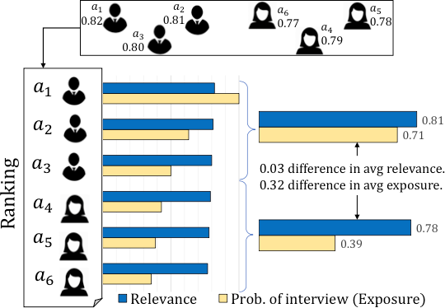
Fairness of Exposure
fairness = exposure ~ merit (relevance)
can we achieve this? almost never
exposure is fixed
merit depends on ranking scores
job applicants
high discrepancy in group exposure
ranking by merit
33
[2018 KDD A. Singh T. Joachims] Fairness of Exposure in Rankings

Slide 39
Fairness of Exposure
what can we do then?
be fair in the long-term: amortized fairness
or be fair probabilistically: probabilistic rankings
formulate an optimization problem
maximize relevance subject to equal exposure, or
minimize exposure discrepancy subject to relevance quality drop
[2018 SIGIR A. Biega et al.] Equity of Attention: Amortizing Individual Fairness in Rankings
[2018 KDD A. Singh T. Joachims] Fairness of Exposure in Rankings

Slide 40
Fairness in Recommendations

Slide 41

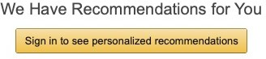
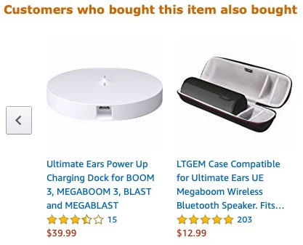
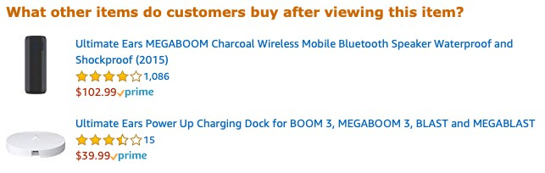
What are recommender systems?
36

Slide 42



Stakeholders in recommender systems
recommenders = match users with items
users
recommender
items
consumers
system provider
producers
a multi-sided market with possibly conflicting interests and various fairness concerns
37

Slide 43
Fairness in recommendations
fairness is the fair distribution of a resource
to make it less abstract and cyclic, answer three questions:
fair for whom? (which are the protected groups)
consumers (end users, buyers)
producers (item providers, creators, sellers)
distribution of what resource?
accuracy (effectiveness, utility, satisfaction, quality of service, etc.)
e.g., items are good matches for users; users are good matches to items
exposure (attention)
e.g., what users see; to whom items are recommended
when is the distribution fair?
specify the optimal state of fairness
quantify how far the optimal state is = define some (un-)fairness measure
38

Slide 44
Taxonomy of fairness definitions in recommenders
of what?
accuracy
exposure
prediction accuracy [2017 NeurIPS S. Yao et al.] ranking accuracy [2018 FAT M. Ekstrand et al.] | equal exposure [2018 FAT R. Burke et al.]
 | exposure coverage [2018 CIKM, 2019 RecSys]
ranking accuracy [2019 KDD A. Beutel et al.] | equal exposure [2018 FAT R. Burke et al.]
 | calibrated exposure [2018 RecSys]
consumer
for whom?
producer
some representative works

Slide 45









Accuracy in recommender systems
accuracy exposure
producer consumer
view 1: the recommender matches users with items
user-item pair
actual rating
predicted rating
prediction accuracy: how good is the matching (regression task)
metrics: absolute error (MAE), root mean square error (RMSE)
view 2: the recommender ranks items for a user
clicked item
ranking accuracy: how good is the ranking (ranking task)
metrics: reciprocal rank (RR), discounted cumulative gain (DCG)
1 2 3 4 5 6
ranking position
reciprocal rank (RR) = 1/2

Slide 46












Fairness of accuracy for consumers
accuracy exposure
producer consumer
“Males and females should experience the same quality of service.”
RR
1
operationalized as:
group users by gender
measure total accuracy per gender
assess if distribution is fair
female
male
1
clicked item
1/3
mean RR
per gender
1/2
f m
position 1 2
3

Slide 47

















Fairness of accuracy for producers
accuracy exposure
producer consumer
“When recommending products, all brands should have similar accuracy.”
operationalized as:
group items by brand
measure total accuracy per brand
assess if distribution is fair
RR
1/3
brand A
brand B
1
clicked item
1/4
mean RR per brand
1/2
1 2
3 4 5
ranking position
6
A B
42

Slide 48












Fairness of exposure for consumers
accuracy exposure
producer consumer
“When recommending jobs, males and females should see the same number of executive openings.”
operationalized as:
group users by gender
measure total exposure
per gender
assess if distribution is fair
female
male
desired items
total exposure
per gender
f m
position 1 2 3 exposure
43

Slide 49




Fairness of exposure for producers
accuracy exposure
producer consumer
“When recommending products, all brands should be fairly exposed.”
operationalized as:
group items by producer
measure total exposure per producer
assess if the distribution is fair
producer A
producer B
total exposure
per producer
recommendations
position exposure per rank
1
2
3 4 5
6
A B

Slide 50
How to Achieve Fairness

Slide 51
How to Achieve Fairness
Data
Task
Outcome
pre-processing
in-processing
post-processing
three types of intervention

Slide 52
Post-Processing for Group Parity in Ranking
Step 1. Determine minimum representation from the protected group in each
prefix
Suppose we want at le -N
ast | 40%𝑁 |  |  | orange at every top
N |  | 1 | 2 | 3 | 4 | 5 | 6 | 7 | 8 | 9 | 10
# orange |  | 0 | 0 | 1 | 1 | 2 | 2 | 2 | 3 | 3 | 4
Step 2. Create two sublists of objects (blue and orange), sorted on score
a
b
c
d
e
f
g
h
i
j
k |  | l
better
better
Step 3. Build the ranked list incrementally
at each rank choose the best from either group (why best?),
unless you must choose from the protected (to ensure minimum representation)
a b g c h d e i f j
rank
1 2 3 4 5 6 7 8 9 10

Slide 53










Post-Processing for Fair Exposure in Ranking
change the position of items to improve fairness trade-off between fairness and accuracy
reranking goal: equalize exposure
total exposure
per producer
reranked list
reranking
A B
original list
total exposure
per producer
1 2
3
4 5 6
producer A
A B
producer B
48

Slide 54
Post-Processing for Ranking
the original list optimizes some internal measure of utility
e.g., relevance, click-through rate
but to increase fairness, the list has to be reranked
at the expense of utility
reranking must trade-off two objectives: utility and fairness
possibilities: maxU maxF U+F
maximize utility given a constraint on fairness maximize fairness given a constraint on utility maximize a combination of utility and fairness

Slide 55
Other Fairness Challenges

Slide 56
Continuous Protected Attributes
All definitions compare a protected group (e.g., blacks, women) against the non-protected
What happens in the case of continuous protected attributes, e.g.,
age, income, location
Groups are not defined beforehand, and defining them can lead to gerrymandering
purposefully setting the group boundaries to hide discrimination
51

Slide 57
Continuous Protected Attributes
All definitions compare a protected group (e.g., blacks, women) against the non-protected
What happens in the case of continuous protected attributes, e.g.,
age, income, location
Spatially Fair Distribution of Outcomes
Groups are not defined beforehand, and defining them can lead to gerrymandering
purposefully setting the group boundaries to hide discrimination
Spatially Unfair Distribution of Outcomes
X | O | X | O
O | X | O | X
X | O | X | O
O | X | O | X
X | X | O | O
X | O | X | O
X | X | O | O
X | X | O | O
51

Slide 58
Continuous Protected Attributes
All definitions compare a protected group (e.g., blacks, women) against the non-protected
What happens in the case of continuous protected attributes, e.g.,
age, income, location
Spatially Fair Distribution of Outcomes
Groups are not defined beforehand, and defining them can lead to gerrymandering
purposefully setting the group boundaries to hide discrimination
X | O | X | O
O | X | O | X
X | O | X | O
O | X | O | X
X O | O X | X O | O X
X O | O X | X O | O X
X | O | X | O
O | X | O | X
X | O | X | O
O | X | O | X
Spatially Unfair Distribution of Outcomes
X | X | O | O
X | O | X | O
X | X | O | O
X | X | O | O
X X | X O | O X | O O
X X | X X | O O | O O
X | X | O | O
X | O | X | O
X | X | O | O
X | X | O | O
1 x 1
2 x 2
1 x 4
51

Slide 59
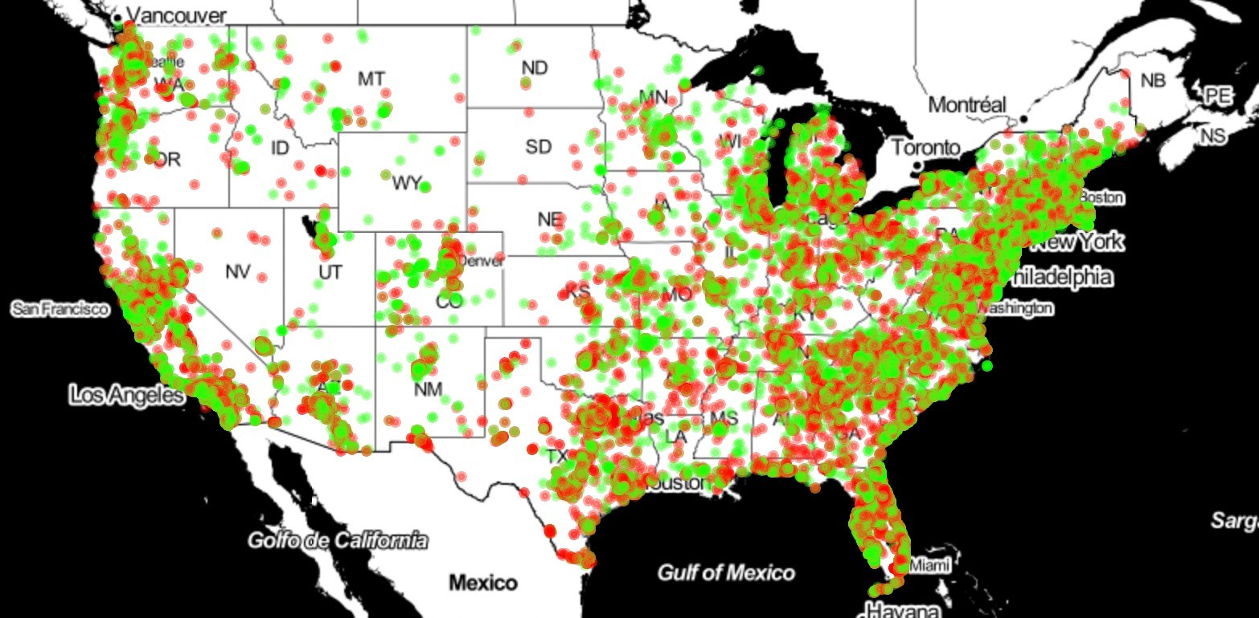
Location Fairness
We want outcomes to be independent of location
Consider Loan Application Accepts and Rejects per location
Is this map fair?

Slide 60
Discover Unfairness via Explanations
Previous definitions require the groups (protected vs. non-protected) to be fixed and known in advance
Can you discover groups (or sub-groups) where discrimination occurs?
Counterfactual Explanations
A person x does not receive a loan
x = {Race=Caucasian, Gender=Female, Income=Low}
What are the minimal changes to receive the loan?
{Gender=Female} → {Gender=Male}
This shows discrimination based on gender!

